Slide 1
Chapter 10 - Collecting Data Using Attitudinal Scales

Slide 2
Topics covered
Attitudinal scales in research
Function of attitudinal scales
Developing attitudinal scales
Types of attitudinal scales
  Likert scale
  Thurstone scale
  Guttman scale
Attitudinal scales and measurement scales

Slide 3
Attitudinal scales in research
Helps to find out how people feel towards certain issues and situations (level of satisfaction, agreement, positive/negative attitude, etc.)
Quantitative research explores types of attitudes, how many people have a certain attitude and intensity of attitude
Qualitative research explores the spread of attitudes and establish types of attitudes
Attitude scales are prevalent in quantitative research such as the Likert scale

Slide 4
Function of attitudinal scales
Measure of intensity of respondents’ attitudes toward the various aspects of a situation or issue
Provide techniques to combine the attitude toward different aspects into on overall indicator

Slide 5
Developing attitudinal scales
Which aspects of a situation or issue should be included when seeking to measure an attitude towards an issue or problem?
What procedure should be adopted for combining the different aspects to obtain an overall picture?
How can one ensure that a scale really is measuring what it is supposed to measure?

Slide 6
Types of attitudinal scales
The summated rating scale, also known as the Likert scale;
The equal-appearing interval scale or differential scale, also known as the Thurstone scale;
The cumulative scale, also known as the Guttman scale.

Slide 7
Likert Scale
Most common attitudinal scale
Measures intensity of attitude toward an issue
Each statement has equal attitudinal value
Measures in categories or on a numerical scale
1, 2 or 3 dimensions of attitudes (e.g. 2 as in positive and negative)
Scores will be assigned to the attitude scale if calculations are used for weighting responses

Slide 8
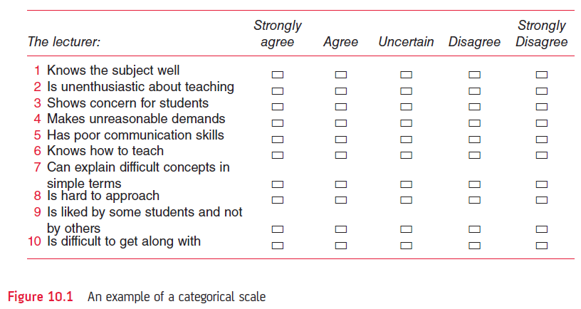
Figure 10.1 An example of a categorical scale

Slide 9
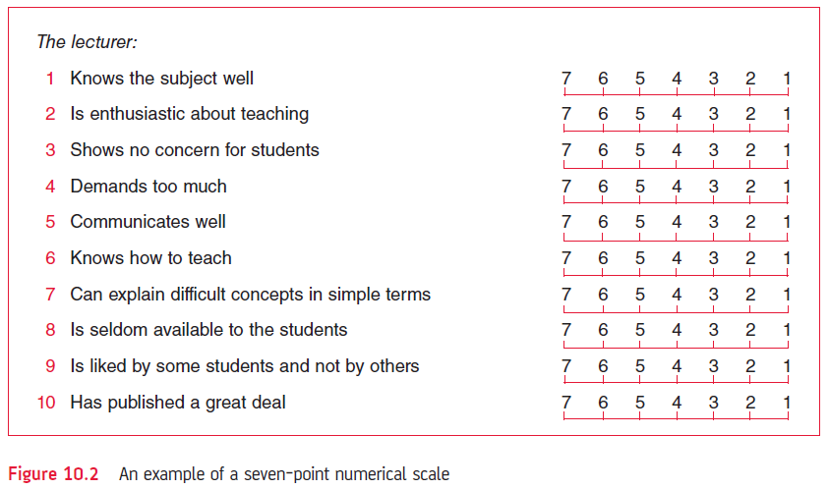
Figure 10.2 An example of a seven point scale

Slide 10
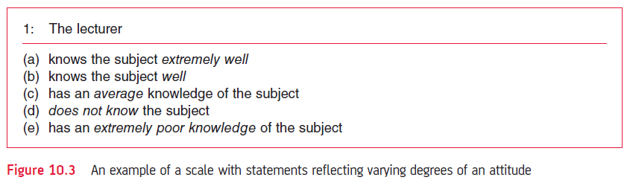
Figure 10.3 An example of a scale with statements reflecting varying degrees of an attitude

Slide 11
Other scales
Thurstone scale:
Calculates an attitudinal value for each statement
Mean score is recorded for each statement
The mean score is equivalent to the attitudinal value assigned by a group of judges
Reflects absolute rather than relative attitudes
Guttman scale:
Cumulative scale which is rarely used

Slide 12
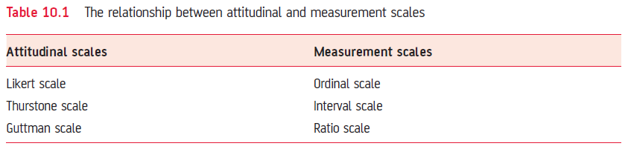
Attitudinal scales and measurement scales
Table 10.1 The relationship between attitudinal and measurement scales

